Slide 1


Slide 2


Enterprise-grade Blazor apps with .NET 6
Daniel Roth
Microsoft

Slide 3




Modern web UI with .NET & Blazor
Server
WebAssembly
Hybrid

Slide 4
Part of the ASP.NET Core family
Web UI
Services
MVC
Razor Pages
HTTP APIs
SignalR
SPA
Blazor
Worker
gRPC
Notes:
ASP.NET Core comes with everything you need to build beautiful web UI and powerful backend services. The addition of Blazor to ASP.NET Core expands the reach of your .NET web apps to the client.

Slide 5


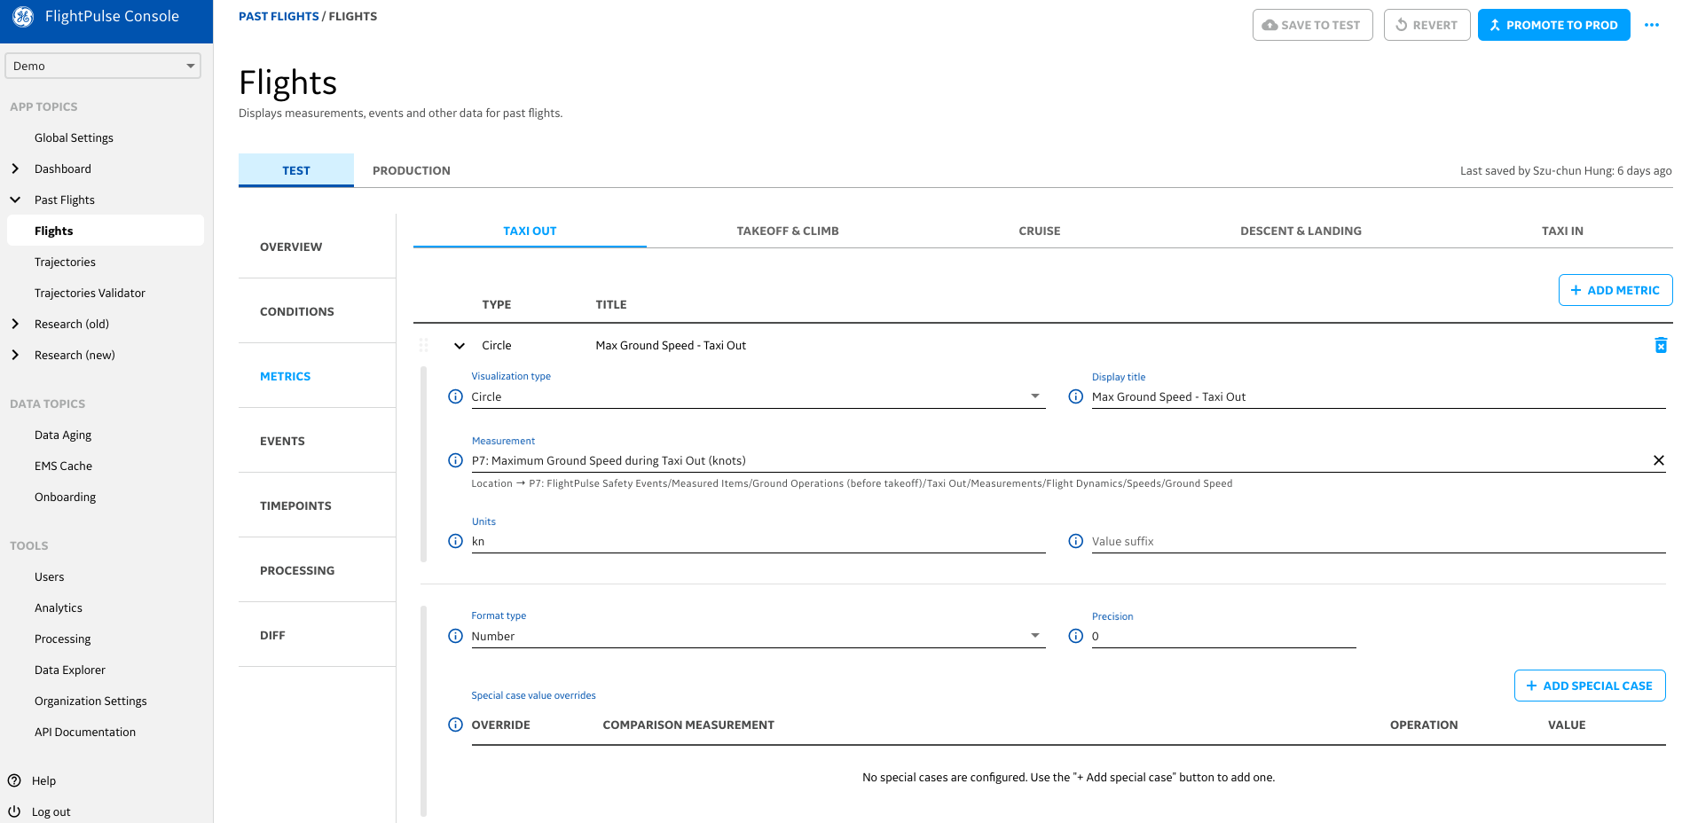
Uses Blazor as part of FlightPulse, an app that puts data and analytics in the hands of more than 3,000 Qantas pilots to help them improve safety and efficiency on every flight.

Slide 6

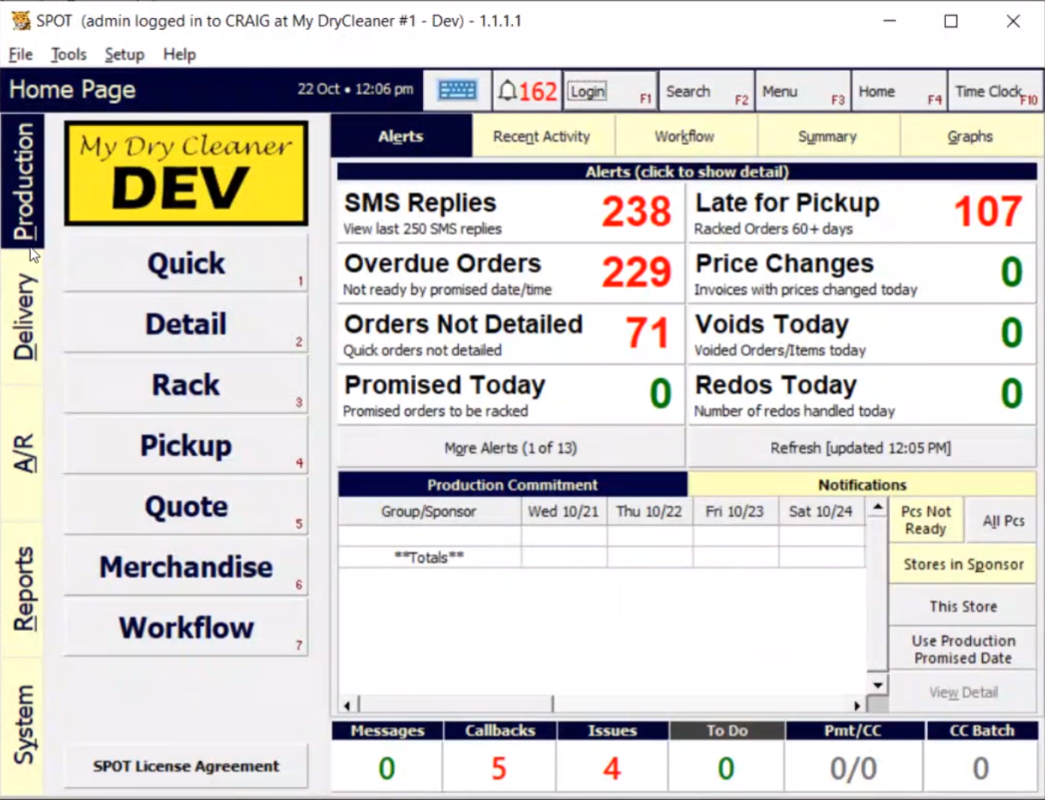
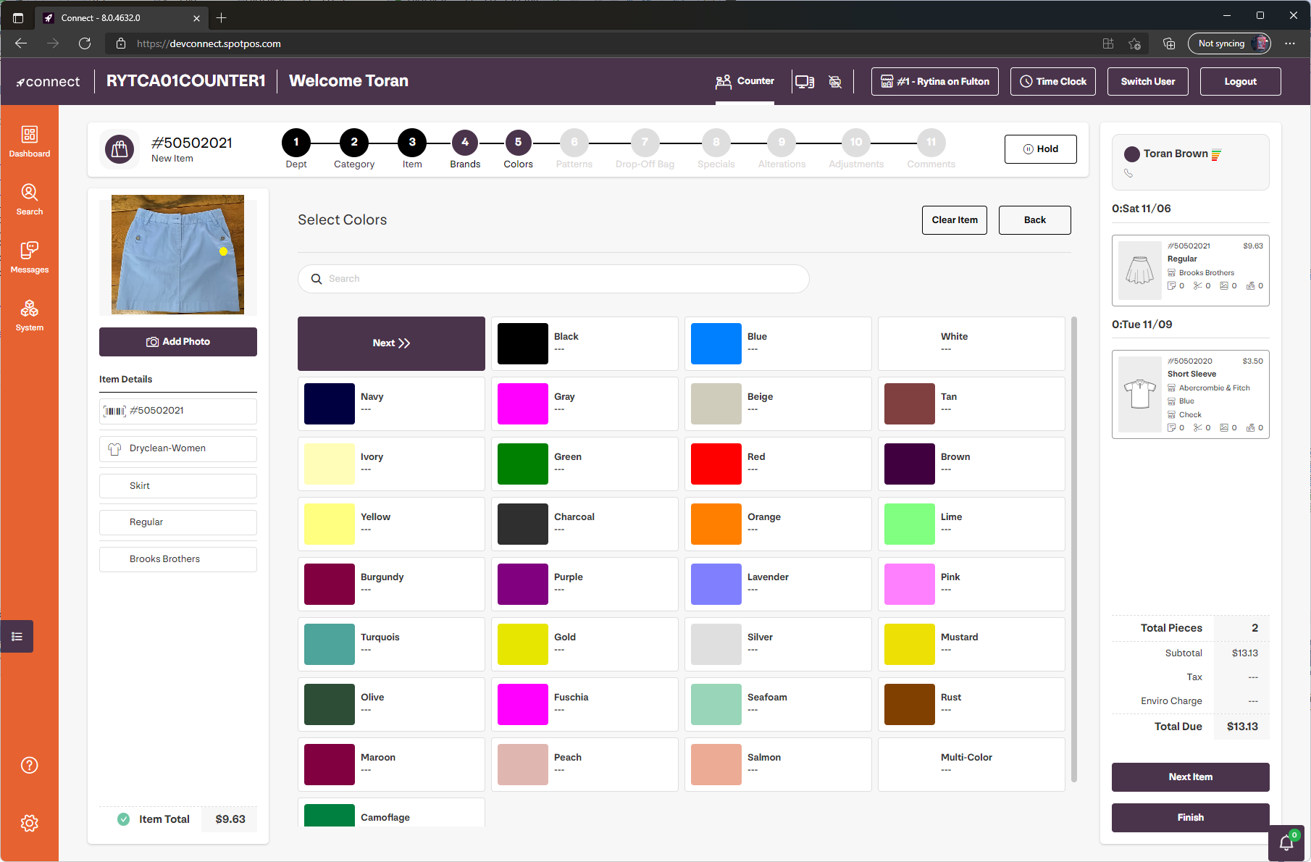



Leading end-to-end solutions for the dry cleaning industry
Modernized existing POS offering and deployed to the web using Blazor

Slide 7
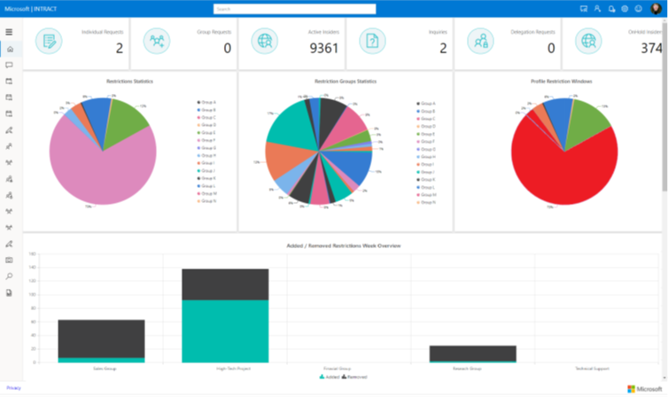

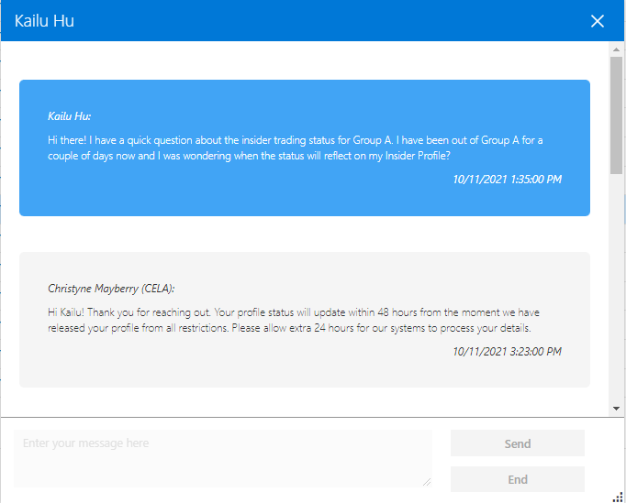
INTRACT (Insider Trading Compliance Platform)
Identify and notify insiders at Microsoft of their responsibilities when trading Microsoft securities.
Administrative functions for tracking groups, managing restrictions, identifying anomalies using machine learning, and reporting.
Also built with ASP.NET Core, Entity Framework Core, ML.NET, and Azure infrastructure.

Slide 8

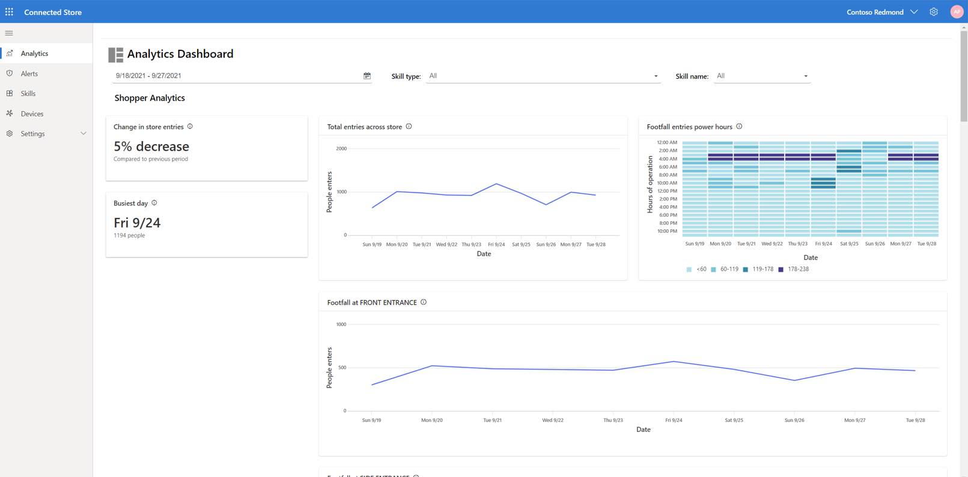
Dynamics 365
Connected Store
Optimize in-store operations with real-time observational data.
Blazor web app for in-store setup and configuration.

Slide 9
Blazor in .NET 6
.NET Hot reload
State persistence during prerendering
Error boundaries
WebAssembly AOT
Runtime relinking
Native dependencies
Smaller download size
Dynamic component rendering
Render components from JS
Custom event args
JavaScript initializers
JavaScript modules per component
Infer generic types from parent
Generic type constraints
Handle large binary data
Remove SignalR message size limitations
Required parameters
Handle query string parameters
Influence the HTML head
SVG support

Slide 10




Get started with Blazor
Go to https://blazor.net
Install the .NET SDK
Visual Studio
Visual Studio for Mac
Visual Studio Code
+ C# extension

Slide 11
Demo

Slide 12
.NET WebAssembly build tools
Ahead-of-time (AOT) compilation
Runtime relinking
Native dependencies

Slide 13

Blazor WebAssembly trimming
.NET 5
.NET 6
Publish size: 1.7 MB
Publish size: 1.0 MB
~40% size reduction

Slide 14
Blazor in .NET 6
.NET Hot reload
State persistence during prerendering
Error boundaries
WebAssembly AOT
Runtime relinking
Native dependencies
Smaller download size
Dynamic component rendering
Render components from JS
Custom event args
JavaScript initializers
JavaScript modules per component
Infer generic types from parent
Generic type constraints
Handle large binary data
Remove SignalR message size limitations
Required parameters
Handle query string parameters
Influence the HTML head
SVG support

Slide 15



More Blazor at .NET Conf – Day 1
Talk | Speakers | Time (PT)
Next-generation Blazor components with .NET 6 | Daniel Roth, Javier Calvarro Nelson | 2:00pm
Build cross-platform native apps with .NET MAUI and Blazor | Eilon Lipton | 3:30pm
CodeParty! | Jeff Fritz | 5:00pm

Slide 16
More Blazor at .NET Conf – Day 2
Talk | Speakers | Time (PT)
New WebAssembly capabilities in .NET 6 | Steve Sanderson | 9:00am
Full-stack .NET with Blazor WebAssembly and Azure Static Web Apps | Anthony Chu Simona Cotin | 10:30am
Microsoft Teams app development with Visual Studio and .NET | John Miller Pierce Boggan | 12:00pm
Blazor Azure B2C Authentication and Authorization | Michael Washington | 7:30pm
Developing & Deploying a Static Blazor Web App with Azure Functions Backend | Matthias Koch | 10:30pm
Connecting gadgets to Blazor | Jimmy Engström | 11:00pm

Slide 17
More Blazor at .NET Conf – Day 3
Talk | Speakers | Time (PT)
Building A Production Ready Blazor WASM App | Steve Peirce | 12:30am
Blazor and GraphQL | Poornima Nayar | 4:00am
Responsive and Adaptive Tactics for Blazor Applications | Ed Charbeneau | 9:00am
Embedding Power BI Reports in your Blazor site | Édgar Sánchez Gordón | 12:00pm
Host, deploy, and scale ASP.NET Core Blazor Server | Jose Javier Columbie | 4:00pm

Slide 18

Thanks for joining!

Slide 19
Announcement
Value prop 1
Value prop 2
Value prop 3

Slide 20







Slide 21








Slide 22







Slide 23









Slide 24





Slide 25


Slide 26


Slide 27


Slide 28


Slide 29


